Slide 1
INTRODUCTION TO MRI
Lynne J. Williams, Ph.D.
BCCH MRI Research Facility
June 5, 2018
DTI II

Slide 2
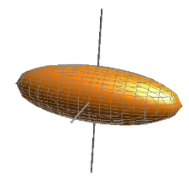
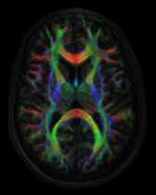
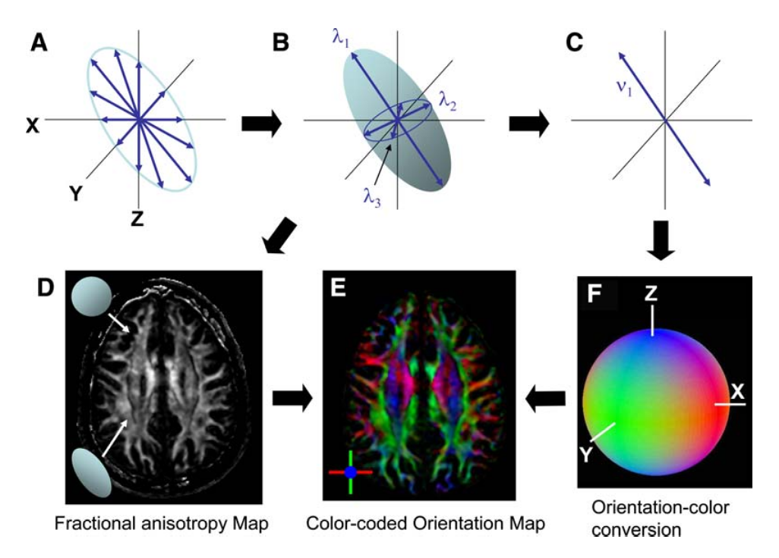
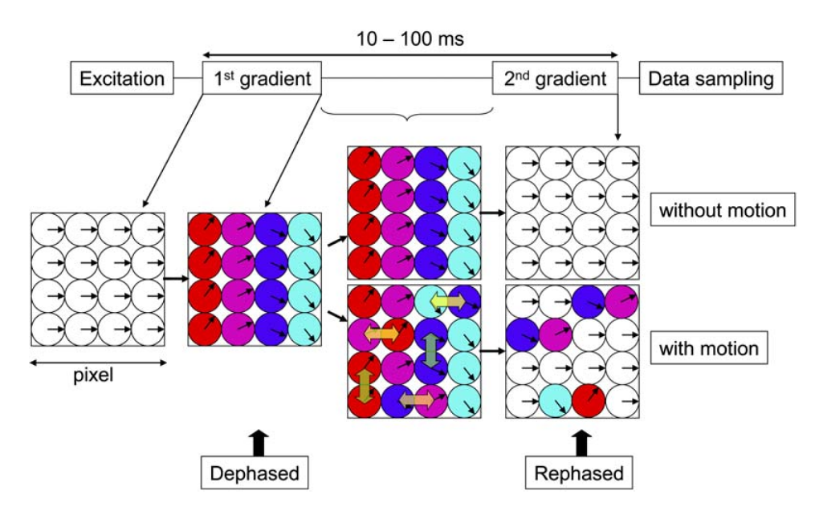
DIFFUSION TENSOR IMAGING
Diffusion Tensor Imaging (DTI) is an anatomical MRI technique that measures macroscopic axonal organization in the brain by using the diffusion of water molecules to generate contrast in MR images.
tensor
imaging
diffusion
Davide Bono & Roser Cañigueral (2017)
University College London
Notes:
2

Slide 3
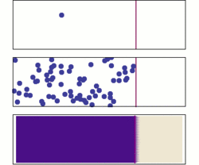
DIFFUSION TENSOR IMAGING
THE DIFFUSION PRINCIPLE
Brownian/translational motion of water molecules.
This motion is influenced by Fick’s Law
a solute will move from a region of high concentration to a region of low concentration across a concentration gradient
Davide Bono & Roser Cañigueral (2017)
University College London
Notes:
J is the "diffusion flux," of which the dimension is amount of substance per unit area per unit time, so it is expressed in such units as mol m⁻² s⁻¹. J measures the amount of substance that will flow through a unit area during a unit time interval.
D is the diffusion coefficient or diffusivity. Its dimension is area per unit time, so typical units for expressing it would be m²/s.
φ {\displaystyle \varphi } (for ideal mixtures) is the concentration, of which the dimension is amount of substance per unit volume. It might be expressed in units of mol/m³.
x is position, the dimension of which is length. It might thus be expressed in the unit m.
D is proportional to the squared velocity of the diffusing particles, which depends on the temperature, viscosity of the fluid and the size of the particles according to the Stokes-Einstein relation. In dilute aqueous solutions the diffusion coefficients of most ions are similar and have values that at room temperature are in the range of 0.6 × 10⁻⁹ to 2 × 10⁻⁹ m²/s. For biological molecules the diffusion coefficients normally range from 10⁻¹¹ to 10⁻¹⁰ m²/s.
3

Slide 4
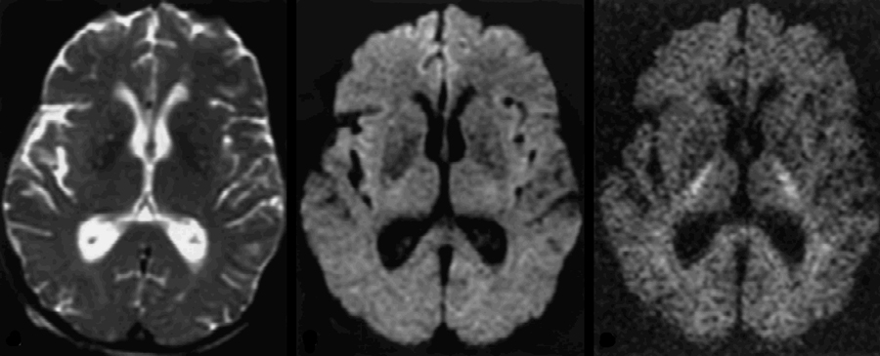
Optimal b value?
DIFFUSION TENSOR IMAGING
DIFFUSION MEASURED BY MRI
b = 0
b = 1000
b = 3000
http://mriquestions.com/what-is-the-b-value.html

Slide 5
DIFFUSION TENSOR IMAGING
THE TENSOR MODEL
EIGEN-
DECOMPOSITION
Eigenvalues
Eigenvectors
diffusivity of axes
(longest, middle, shortest)
orientation of axes
Davide Bono & Roser Cañigueral (2017)
University College London

Slide 6
WEEK 6
DIFFUSION MRI II &
BUILD EXPERIMENT
TODAY’S CLASS
Q Space
Build your own experiment

Slide 7
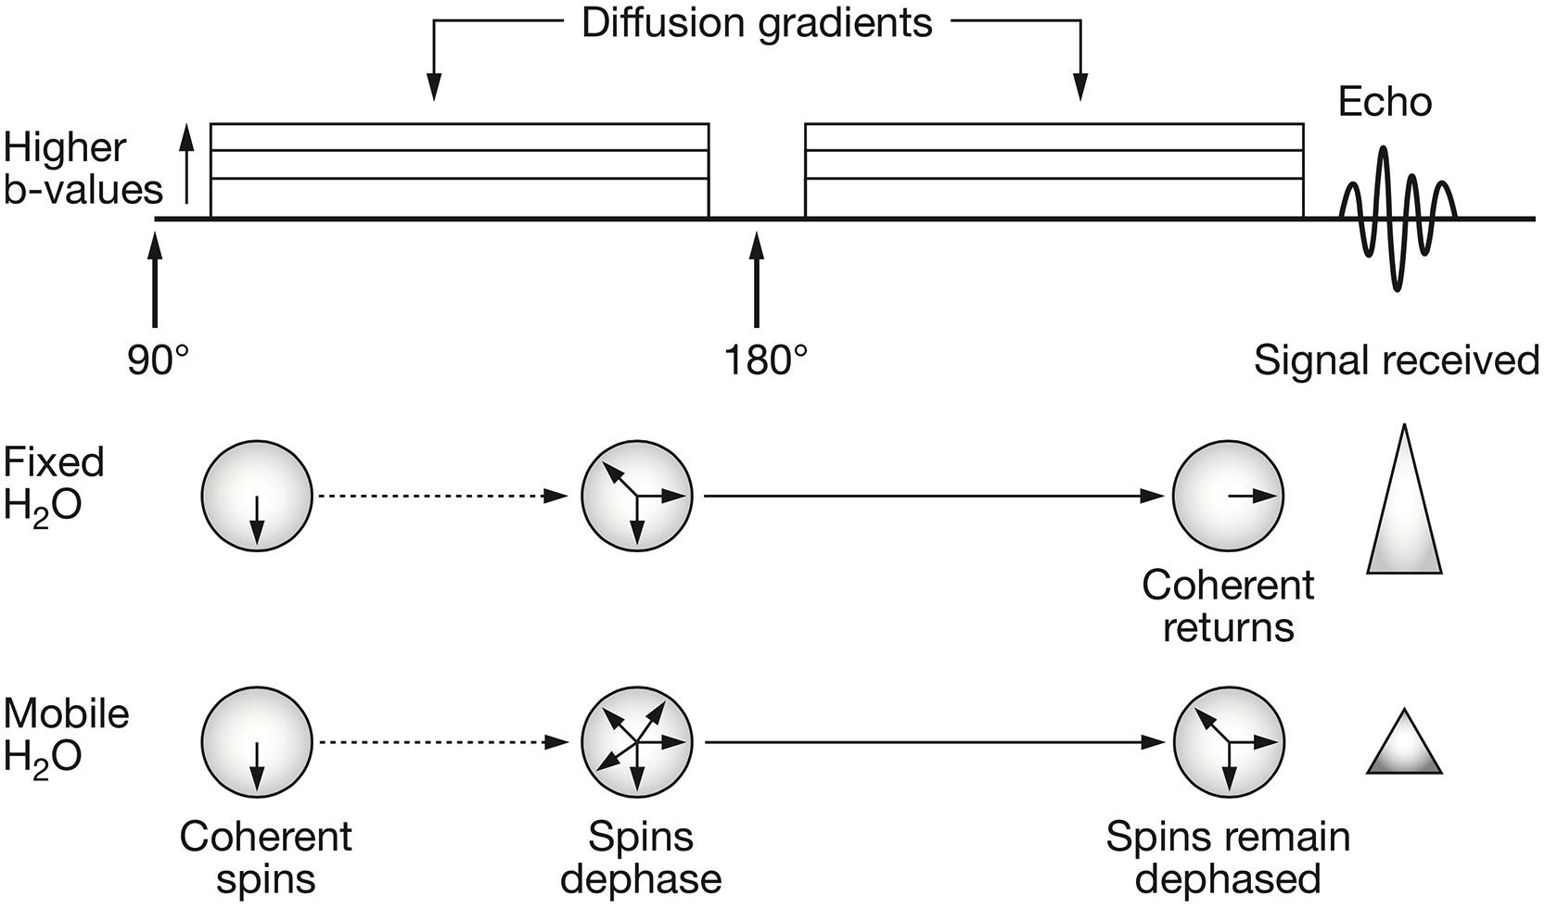
DIFFUSION WEIGHTING
DIFFUSION GRADIENTS
Patterson et al. 2008 in Bastiani & Roebroeck (2015). Frontiers in Neuroanatomy.
Notes:
The classical PGSE sequence consists in the application of an initial 90° radiofrequency (RF) pulse and a refocusing 180° RF pulse. When interested in probing the diffusion behavior of water molecules, two diffusion gradient pulses are applied. These are characterized by amplitude (|G|), duration (δ) and time between their application (Δ). The diffusion gradients tag the spins of moving water molecules. This means that, those spins that move along the direction of the applied q-vector will elicit a signal reduction since they will have lost their coherence. The free induction decay signal is then acquired at echo time. (Patterson et al., 2008).

Slide 8
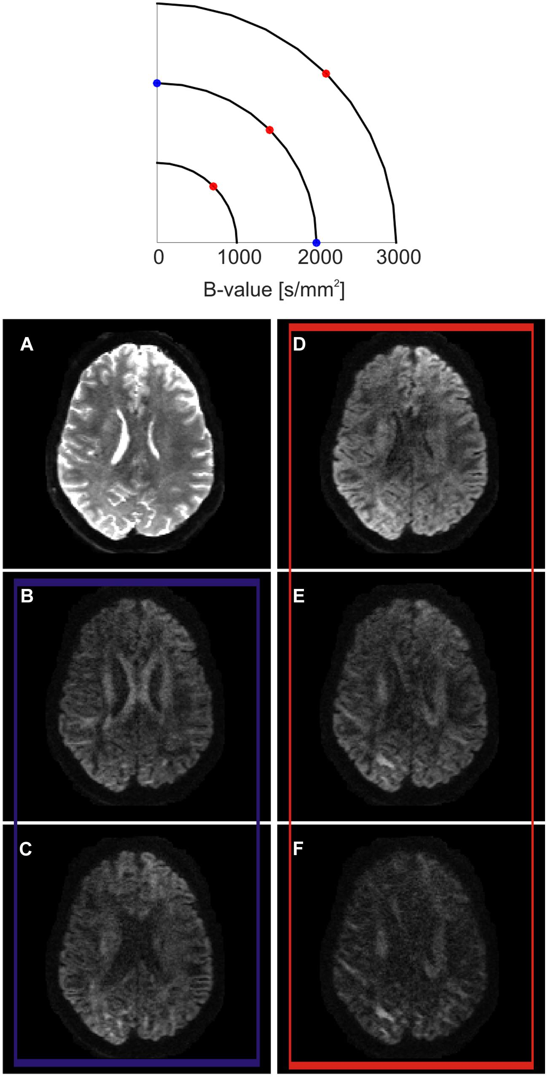
DIFFUSION WEIGHTING
Q SPACE
B₀ “T₂” diffusion image
The diffusion gradients could be said to probe a three-dimensional space called q-space
Every sampled point can be represented using vector
Bastiani & Roebroeck (2015). Frontiers in Neuroanatomy.
Notes:
Q-space imaging consists in estimating the full probability distribution of water molecules’ displacement, the so-called diffusion propagator, or its statistical moments, by sampling points in q-space and using the Fourier transform relationship between q-space and the diffusion propagator
(A) When the diffusion encoding gradients are switched off, the so-called T2-weighted b0 volume is obtained. (B,C) show the effect of sampling q-space at two different diffusion encoding orientations lying on the same b-shell. While SNR and amount of probed diffusion are kept constant, the contrast changes at different anatomical locations. When sampling along the left–right direction, the body of the corpus callosum show a higher signal drop (C) in respect to the sampling along the anterior-posterior direction (B). This reflects the fact that, in the body of the corpus callosum, axons are mainly oriented along the left–right orientation. (D–F) show the effects of sampling along the same diffusion encoding orientation while increasing b-value. In this case, the total SNR decreases while moving from lower to higher b-values, but the contrast increases. As an effect, different anatomical structures are more strongly differentiable between each other according to their main axonal orientation.
8

Slide 9
DIFFUSION WEIGHTING
Q SPACE
Different diffusion encoding orientations lying on same b-shell
The diffusion gradients could be said to probe a three-dimensional space called q-space
Every sampled point can be represented using vector
Bastiani & Roebroeck (2015). Frontiers in Neuroanatomy.
Notes:
Q-space imaging consists in estimating the full probability distribution of water molecules’ displacement, the so-called diffusion propagator, or its statistical moments, by sampling points in q-space and using the Fourier transform relationship between q-space and the diffusion propagator
(A) When the diffusion encoding gradients are switched off, the so-called T2-weighted b0 volume is obtained. (B,C) show the effect of sampling q-space at two different diffusion encoding orientations lying on the same b-shell. While SNR and amount of probed diffusion are kept constant, the contrast changes at different anatomical locations. When sampling along the left–right direction, the body of the corpus callosum show a higher signal drop (C) in respect to the sampling along the anterior-posterior direction (B). This reflects the fact that, in the body of the corpus callosum, axons are mainly oriented along the left–right orientation. (D–F) show the effects of sampling along the same diffusion encoding orientation while increasing b-value. In this case, the total SNR decreases while moving from lower to higher b-values, but the contrast increases. As an effect, different anatomical structures are more strongly differentiable between each other according to their main axonal orientation.
9

Slide 10
DIFFUSION WEIGHTING
Q SPACE
The diffusion gradients could be said to probe a three-dimensional space called q-space
Every sampled point can be represented using vector
Same diffusion encoding orientation with increasing b-value
Bastiani & Roebroeck (2015). Frontiers in Neuroanatomy.
Notes:
Q-space imaging consists in estimating the full probability distribution of water molecules’ displacement, the so-called diffusion propagator, or its statistical moments, by sampling points in q-space and using the Fourier transform relationship between q-space and the diffusion propagator
(A) When the diffusion encoding gradients are switched off, the so-called T2-weighted b0 volume is obtained. (B,C) show the effect of sampling q-space at two different diffusion encoding orientations lying on the same b-shell. While SNR and amount of probed diffusion are kept constant, the contrast changes at different anatomical locations. When sampling along the left–right direction, the body of the corpus callosum show a higher signal drop (C) in respect to the sampling along the anterior-posterior direction (B). This reflects the fact that, in the body of the corpus callosum, axons are mainly oriented along the left–right orientation. (D–F) show the effects of sampling along the same diffusion encoding orientation while increasing b-value. In this case, the total SNR decreases while moving from lower to higher b-values, but the contrast increases. As an effect, different anatomical structures are more strongly differentiable between each other according to their main axonal orientation.
10

Slide 11
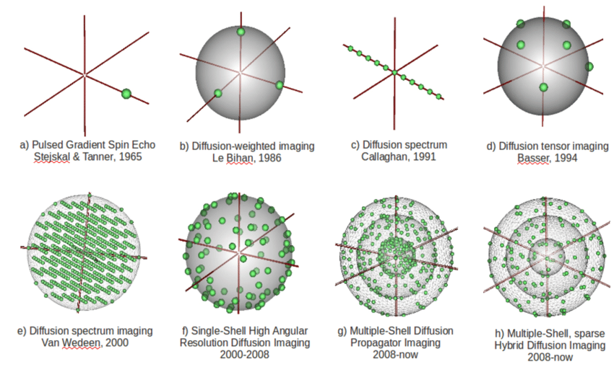
Descoteaux, Maxime & Poupon, Cyril. (2014). Comprehensive Biomedical Physics. Comprehensive Biomedical Physics. 81-97.

Slide 12
WEEK 6
DIFFUSION MRI II &
BUILD EXPERIMENT
BUILD YOUR
OWN EXPERIMENT

Slide 13
Question
MRI Protocol
Structural
T1?
T2?
FLAIR?
Functional?
Task(s)?
Design?
Parameters?
DWI
Parameters?

Slide 14
QUESTION
On a single subject basis, where is the language network localized in the brain in a child with refractory epilepsy?

Slide 15
MRI PROTOCOL
Structural
T1w, T2w, FLAIR
Functional
Language Tasks (but which ones?) → need to be:
Reliable
Replicable
Localizers
DWI
DTI tractography

Slide 16
FUNCTIONAL
No one language task will test all language skills
Semantic Decision
Rhyming
Categorization
Covert Naming
Reading
etc.
Semantic Decision

Slide 17
SEMANTIC DECISION
TR: 3000 ms
Sentence Length: 1 s
Response time: 2 s
ISI: 0 s
True or False
Reverse Speech
30 s
5 min

Slide 18
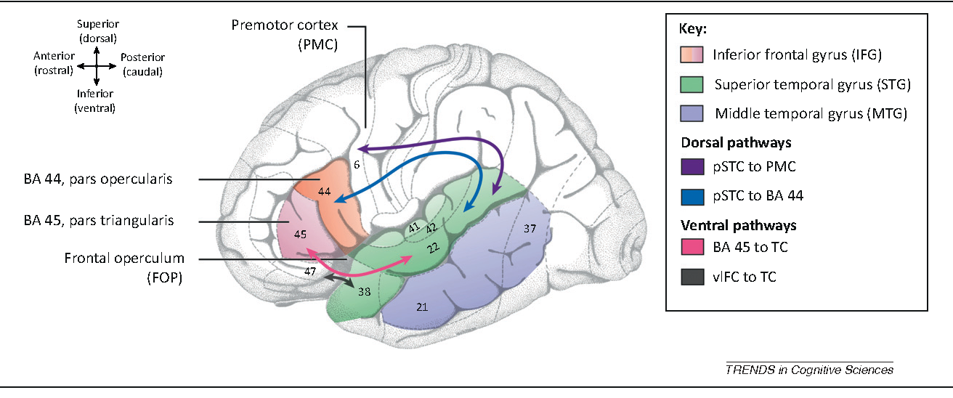
DWI
Berwick et al. (2013).

Slide 19
http://neuropowertools.org

Slide 20
INTRODUCTION TO MRI
DIFFUSION TENSOR IMAGING PART I
THANK YOU

Slide 21
DIFFUSION WEIGHTING
ATTENUATION
DIFFUSION
Random motion of molecules through a medium over time
DIFFUSION WEIGHTING
Application of magnetic gradients to cause changes in MR signal that are dependent upon the amplitude and or direction of diffusion
ATTENUATION
Assuming isotropic diffusion and a constant amplitude of diffusion weighting gradient, the attenuation effect is given by
D = apparent diffusion coefficient
G = strength of the gradient
T = duration of gradient
Notes:
J is the "diffusion flux," of which the dimension is amount of substance per unit area per unit time, so it is expressed in such units as mol m⁻² s⁻¹. J measures the amount of substance that will flow through a unit area during a unit time interval.
D is the diffusion coefficient or diffusivity. Its dimension is area per unit time, so typical units for expressing it would be m²/s.
φ {\displaystyle \varphi } (for ideal mixtures) is the concentration, of which the dimension is amount of substance per unit volume. It might be expressed in units of mol/m³.
x is position, the dimension of which is length. It might thus be expressed in the unit m.
D is proportional to the squared velocity of the diffusing particles, which depends on the temperature, viscosity of the fluid and the size of the particles according to the Stokes-Einstein relation. In dilute aqueous solutions the diffusion coefficients of most ions are similar and have values that at room temperature are in the range of 0.6 × 10⁻⁹ to 2 × 10⁻⁹ m²/s. For biological molecules the diffusion coefficients normally range from 10⁻¹¹ to 10⁻¹⁰ m²/s.
21

Slide 22
DIFFUSION WEIGHTING
ATTENUATION
ATTENUATION
Assuming isotropic diffusion and a constant amplitude of diffusion weighting gradient, the attenuation effect is given by
D = apparent diffusion coefficient
G = strength of the gradient
T = duration of gradient
Notes:
J is the "diffusion flux," of which the dimension is amount of substance per unit area per unit time, so it is expressed in such units as mol m⁻² s⁻¹. J measures the amount of substance that will flow through a unit area during a unit time interval.
D is the diffusion coefficient or diffusivity. Its dimension is area per unit time, so typical units for expressing it would be m²/s.
φ {\displaystyle \varphi } (for ideal mixtures) is the concentration, of which the dimension is amount of substance per unit volume. It might be expressed in units of mol/m³.
x is position, the dimension of which is length. It might thus be expressed in the unit m.
D is proportional to the squared velocity of the diffusing particles, which depends on the temperature, viscosity of the fluid and the size of the particles according to the Stokes-Einstein relation. In dilute aqueous solutions the diffusion coefficients of most ions are similar and have values that at room temperature are in the range of 0.6 × 10⁻⁹ to 2 × 10⁻⁹ m²/s. For biological molecules the diffusion coefficients normally range from 10⁻¹¹ to 10⁻¹⁰ m²/s.
22

Slide 23
DIFFUSION WEIGHTING
ATTENUATION
B VALUE
Degree of diffusion weighting
ATTENUATION
Assuming isotropic diffusion and a constant amplitude of diffusion weighting gradient, the attenuation effect is given by
D = apparent diffusion coefficient
G = strength of the gradient
T = duration of gradient
Notes:
J is the "diffusion flux," of which the dimension is amount of substance per unit area per unit time, so it is expressed in such units as mol m⁻² s⁻¹. J measures the amount of substance that will flow through a unit area during a unit time interval.
D is the diffusion coefficient or diffusivity. Its dimension is area per unit time, so typical units for expressing it would be m²/s.
φ {\displaystyle \varphi } (for ideal mixtures) is the concentration, of which the dimension is amount of substance per unit volume. It might be expressed in units of mol/m³.
x is position, the dimension of which is length. It might thus be expressed in the unit m.
D is proportional to the squared velocity of the diffusing particles, which depends on the temperature, viscosity of the fluid and the size of the particles according to the Stokes-Einstein relation. In dilute aqueous solutions the diffusion coefficients of most ions are similar and have values that at room temperature are in the range of 0.6 × 10⁻⁹ to 2 × 10⁻⁹ m²/s. For biological molecules the diffusion coefficients normally range from 10⁻¹¹ to 10⁻¹⁰ m²/s.
23

Slide 24
DIFFUSION WEIGHTING
ATTENUATION
B VALUE
Degree of diffusion weighting
ATTENUATION
Assuming isotropic diffusion and a constant amplitude of diffusion weighting gradient, the attenuation effect is given by
D = apparent diffusion coefficient
G = strength of the gradient
T = duration of gradient
Notes:
J is the "diffusion flux," of which the dimension is amount of substance per unit area per unit time, so it is expressed in such units as mol m⁻² s⁻¹. J measures the amount of substance that will flow through a unit area during a unit time interval.
D is the diffusion coefficient or diffusivity. Its dimension is area per unit time, so typical units for expressing it would be m²/s.
φ {\displaystyle \varphi } (for ideal mixtures) is the concentration, of which the dimension is amount of substance per unit volume. It might be expressed in units of mol/m³.
x is position, the dimension of which is length. It might thus be expressed in the unit m.
D is proportional to the squared velocity of the diffusing particles, which depends on the temperature, viscosity of the fluid and the size of the particles according to the Stokes-Einstein relation. In dilute aqueous solutions the diffusion coefficients of most ions are similar and have values that at room temperature are in the range of 0.6 × 10⁻⁹ to 2 × 10⁻⁹ m²/s. For biological molecules the diffusion coefficients normally range from 10⁻¹¹ to 10⁻¹⁰ m²/s.
24

Slide 25
DIFFUSION WEIGHTING
MEAN DIFFUSIVITY
(Isotropic only)
or using
TENSOR MODEL
(Isotropic and Anisotropic)
D = apparent diffusion coefficient
G = strength of the gradient
T = duration of gradient
Notes:
J is the "diffusion flux," of which the dimension is amount of substance per unit area per unit time, so it is expressed in such units as mol m⁻² s⁻¹. J measures the amount of substance that will flow through a unit area during a unit time interval.
D is the diffusion coefficient or diffusivity. Its dimension is area per unit time, so typical units for expressing it would be m²/s.
φ {\displaystyle \varphi } (for ideal mixtures) is the concentration, of which the dimension is amount of substance per unit volume. It might be expressed in units of mol/m³.
x is position, the dimension of which is length. It might thus be expressed in the unit m.
D is proportional to the squared velocity of the diffusing particles, which depends on the temperature, viscosity of the fluid and the size of the particles according to the Stokes-Einstein relation. In dilute aqueous solutions the diffusion coefficients of most ions are similar and have values that at room temperature are in the range of 0.6 × 10⁻⁹ to 2 × 10⁻⁹ m²/s. For biological molecules the diffusion coefficients normally range from 10⁻¹¹ to 10⁻¹⁰ m²/s.
25

Slide 26
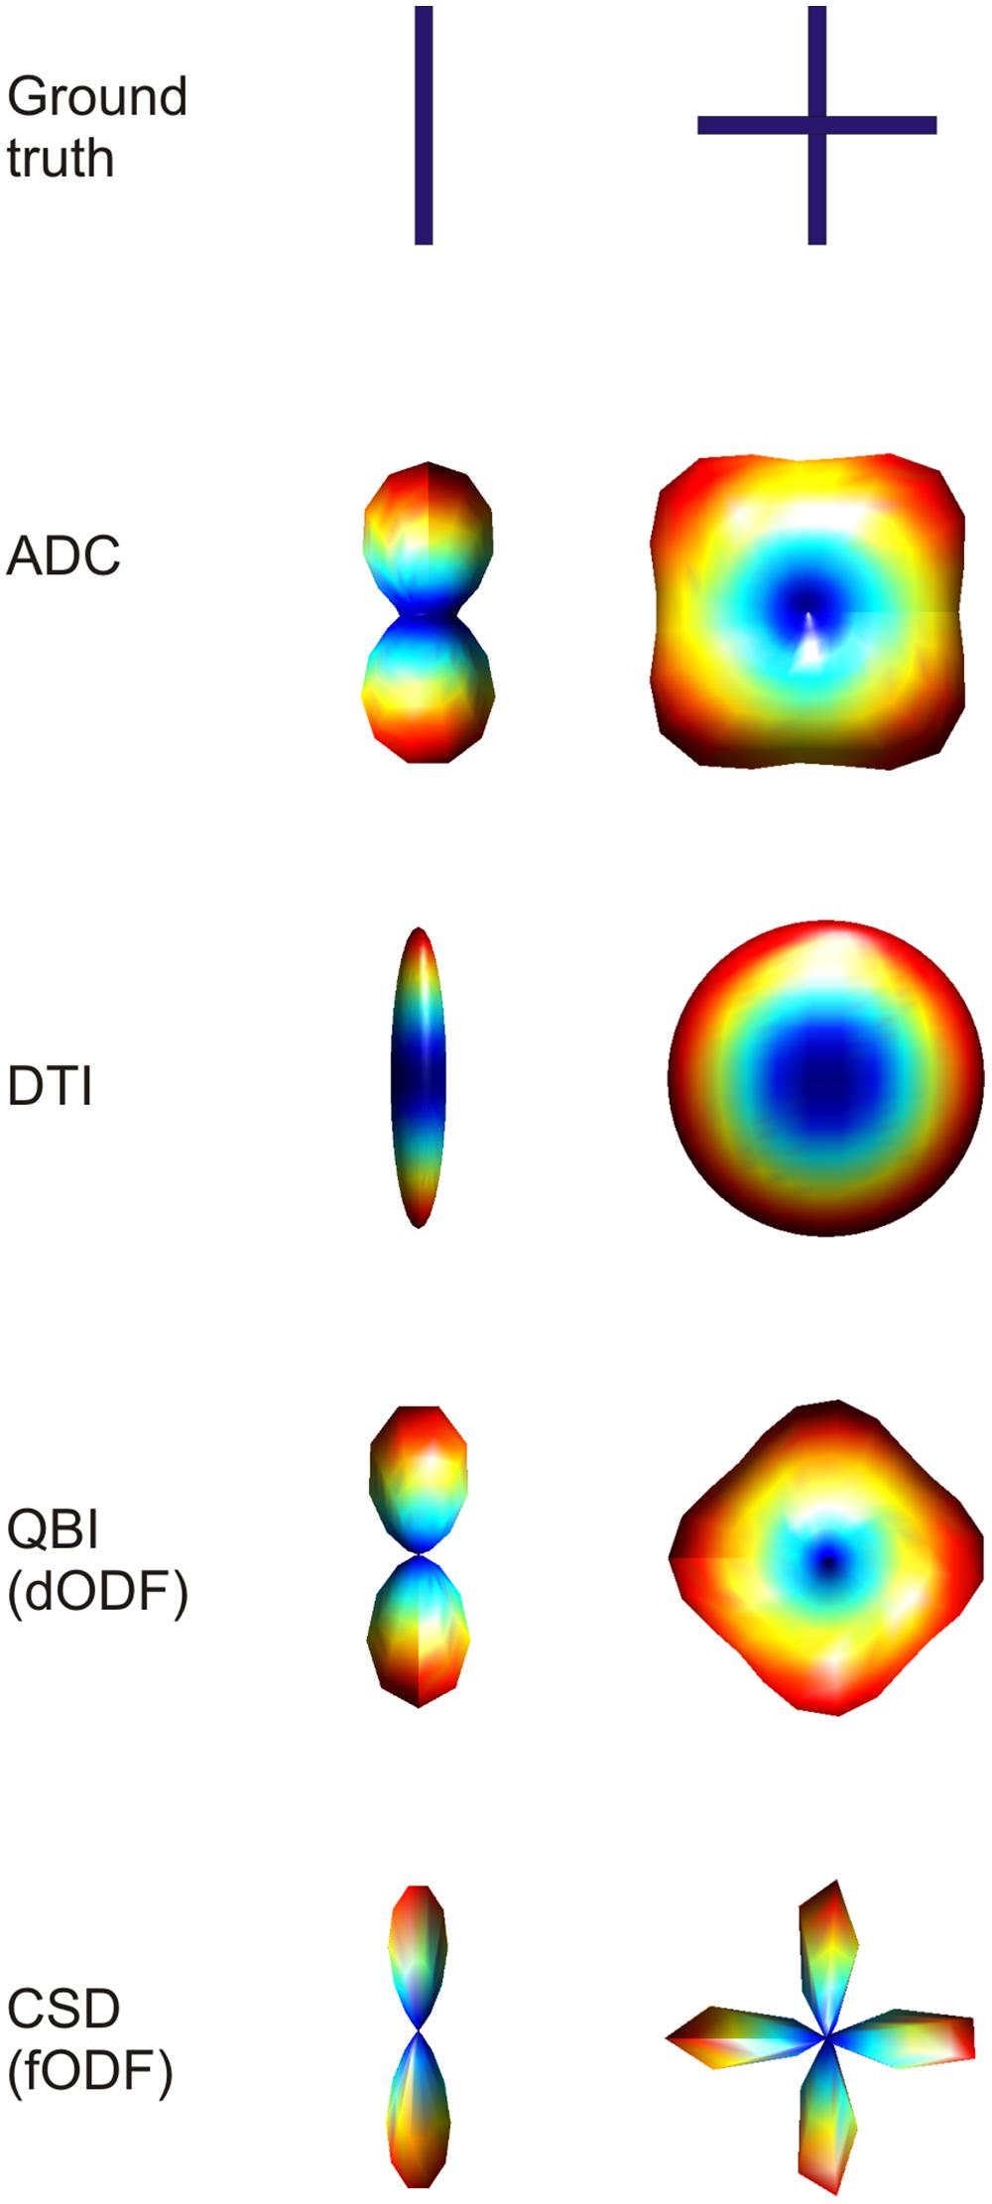
Bastiani & Roebroeck (2015). Frontiers in Neuroanatomy.

Slide 27
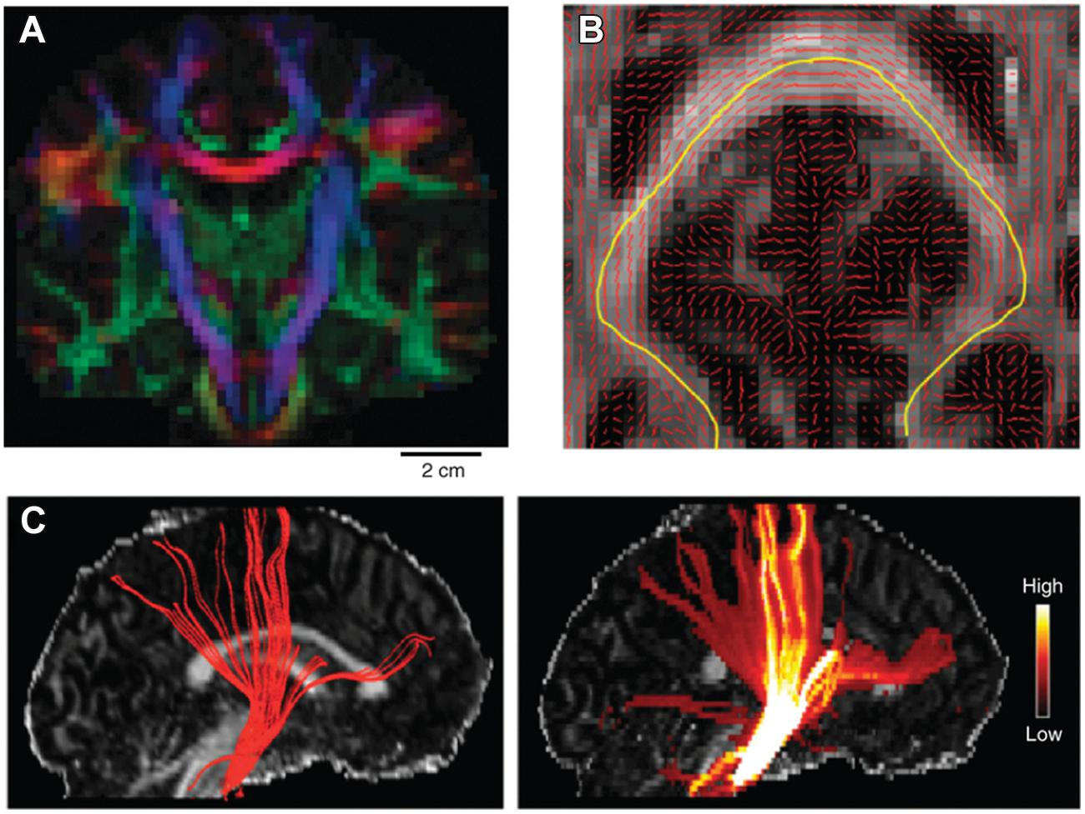
Main DTI eigenvector orientation as a RGB color coded map of a single coronal slice of the human brain.
Bastiani & Roebroeck (2015). Frontiers in Neuroanatomy.

Slide 28
Main eigenvector orientation visualized on top of a FA axial slice. An example streamline is mapped in yellow, which follows the main path crossing the corpus callosum.
Bastiani & Roebroeck (2015). Frontiers in Neuroanatomy.

Slide 29
Tracking the pyramidal tract using a deterministic (left) and a probabilistic (right) approach superimposed on a FA sagittal slice (Craddock et al., 2013).
Bastiani & Roebroeck (2015). Frontiers in Neuroanatomy.

Slide 30
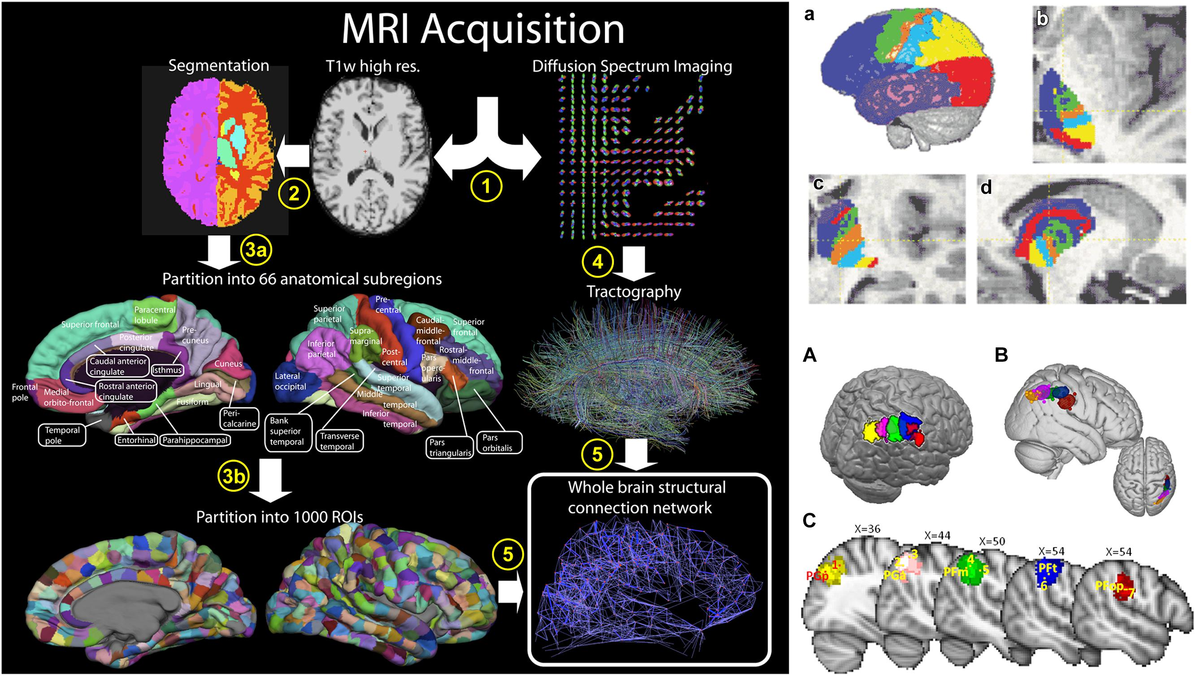
Bastiani & Roebroeck (2015). Frontiers in Neuroanatomy.

Slide 31
Bastiani & Roebroeck (2015). Frontiers in Neuroanatomy.

Slide 32
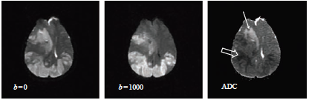
DIFFUSION WEIGHTING
APPARENT DIFFUSION COEFFICIENT IMAGE
McRobbie, D. W., Moore, E. A., Graves, M. J., & Prince, M. R. (2017). To BOLDly Go: fMRI, Perfusion and Diffusion. In MRI from Picture to Proton (3rd ed., pp. 303–325). chapter, Cambridge: Cambridge University Press. http://doi.org/10.1017/9781107706958.019

Slide 33
 | ADC (×10⁻³ mm² s⁻¹) | Relative signal (at b = 1000)
CSF | 2.94 | 0.05
Grey matter | 0.76 | 0.47
White matter | 0.45 | 0.63
White matter parallel to fibres | 0.95 | 0.39
Liver | 1.8 | 0.17
Liver benign (cysts, haemangioma) | 2.5 | 0.08
Liver (metastases, HCC) | 1.1 | 0.33

Slide 34
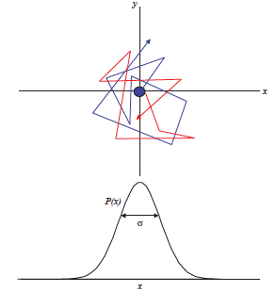
McRobbie, D. W., Moore, E. A., Graves, M. J., & Prince, M. R. (2017). To BOLDly Go: fMRI, Perfusion and Diffusion. In MRI from Picture to Proton (3rd ed., pp. 303–325). chapter, Cambridge: Cambridge University Press. http://doi.org/10.1017/9781107706958.019

Slide 35
